Slide 1
Consumer Search and SEO
Fall 2025
CUHK MSc in Marketing

Slide 2
Overview
How consumers search
How search engines work
Search Engine Optimization (SEO)

Slide 3
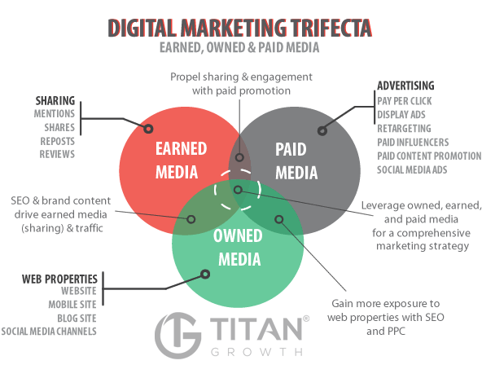
Earned / Owned / Paid
Notes:
Paid media is a great way to promote content in order to increase earned media, it also has the ability to drive traffic directly to your owned media properties. Owned media gives your company the opportunity to interact more with your customers, increasing the relationship with them. This is a very good method if you are able to keep up with the maintenance. Earned media is essentially the new generations version of spreading by word-of-mouth, it can be a great asset to the company if used correctly.
Many people have been of the mindset that you can only use one of the types of media in order to help your business. I am here to tell you that while all three are very different methods of using media to promote your business, there is no need to only use one and throw the other two types to the side. Firstly, I will give a brief explanation of what Forbes describes each different type as.
1) Paid – Forbes magazine says that simply, you “pay for this type of media – tools like Google AdWords”. There was a time when digital marketing was exclusively paid media. However, this is not the case any more. Times have changed, people are currently more interested in doing business with brands they trust and they are using those brands regularly.
2) Owned – This method of media is described as “a media channel created by your business – the content that you own, in entirety”. This could refer to a businesses Facebook page, or YouTube channel. This could be a very effective method of increasing the number of new customers, as it allows customers to see what the business is really like.
3) Earned – This is the best method of using media, it is defined as grabbing the attention of customers and then “turning them into brand advocates and influencers”. This will help to advertise your company to even more possible consumers, but it would appear to be from an outside neutral source. Giving your company an extremely good image.

Slide 4
I: PUSH-Pull (Persuasive messaging)
Email Marketing: Opt-in messages
Very “inexpensive”
main cost is the list—about $.05 ~ $.20 per name
About three-quarters of all email is “spam” (according the Symantec)

Slide 5
I: Push-PULL (Fish where the fish are)
Online Advertising: Display ads (banner and pop-up), rich media and video, search engine advertising, mobile and local
Search engine marketing has had the most impact on the DM space … accounts for about 50% of total online advertising spend
There are about 45+ billion Google searches a month

Slide 6
Consumer Search

Slide 7
Questions
How do you decide on new products to buy?
How do you learn about new content to watch/listen to?

Slide 8
Search types
Information
Navigation
Transaction
Notes:
informational queries seeking knowledge, navigational queries seeking a known destination, and transactional queries seeking to perform a task.
Informational Search
Goal:To find information, facts, or answers to questions.
User Motivation:Curiosity, a desire to learn, or to satisfy an information need.
Examples:"How to make coffee," "What is blockchain technology," or "Latest news about artificial intelligence".
Navigational Search
Goal:To locate a specific website or web page.
User Motivation:To go directly to a known online destination.
Examples:"YouTube," "Spotify login," or "Google search homepage".
Transactional Search
Goal:To complete an action, such as making a purchase, booking a service, or downloading an app.
User Motivation:To take a specific action or make a purchase, indicating they are further along in the customer journey.
Examples:"Buy red shoes," "Book a hotel room," or "Order pizza online".

Slide 9
Search Engine Marketing

Slide 10
Search Engine Results Page (SERP)
Organic Search:
Ranking of websites “relatively unbiased”
Pagerank Algorithm
Paid Search Advertising:
Firms pay search engines to serve ads
Ranking is based on bids

Slide 11
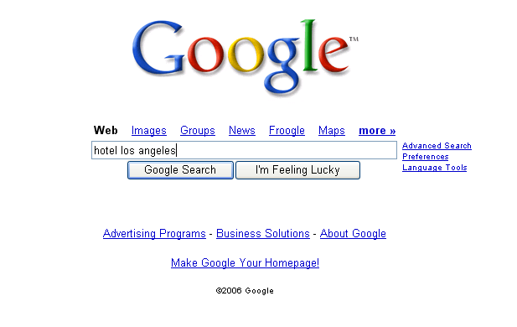
Consumer Search
Notes:
This concept actually stems from John Hagel's and Marc Singer's HBR and McK Quarterly article "Unbundling the Corporation". Their hypothesis is that decreasing interaction costs will drive corporations (or at least those intent on staying competitive) to disaggregate according to the above overall "functions".
We introduce this concept to business unit strategy to help teams focus on those functions of the client and their competitors which are most crucial on the competitive battlefield. Thus most investigative effort will be spent where it really matters. In the pyramid introduced above we give some suggestions which frameworks/tools/concepts can be helpful for further analysis depending on the driver(s) of the business.
Of course many business units will have more than one value driver. A pharmaceutical BU, for example, might very well be competing as a customer relationship business (targeting its sales force for maximum impact with physicians) as well as competing as an innovation business (developing and managing its drug pipeline). Both drivers of the business will need to be examined by the team. In the spirit of Hagel and Singer this might also be the starting point to investigate possibilities to unbundle the functions of the BU or the corporation and have the client focus on the game he's prepared to play best at.

Slide 12
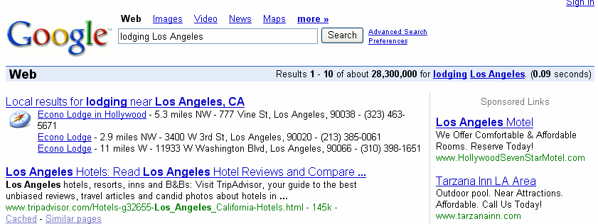
SERP
Organic
Sponsored

Slide 13
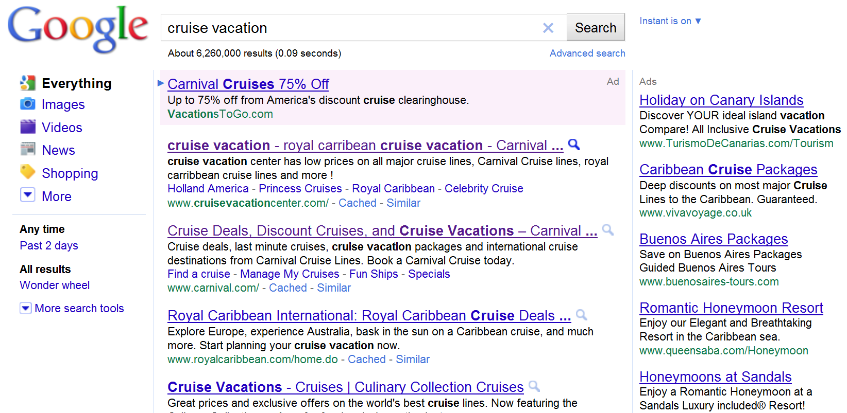
Search Engine Advertising
Paid search results
Rank
Keyword
1
2
3
4
5
6
Organic search results

Slide 14
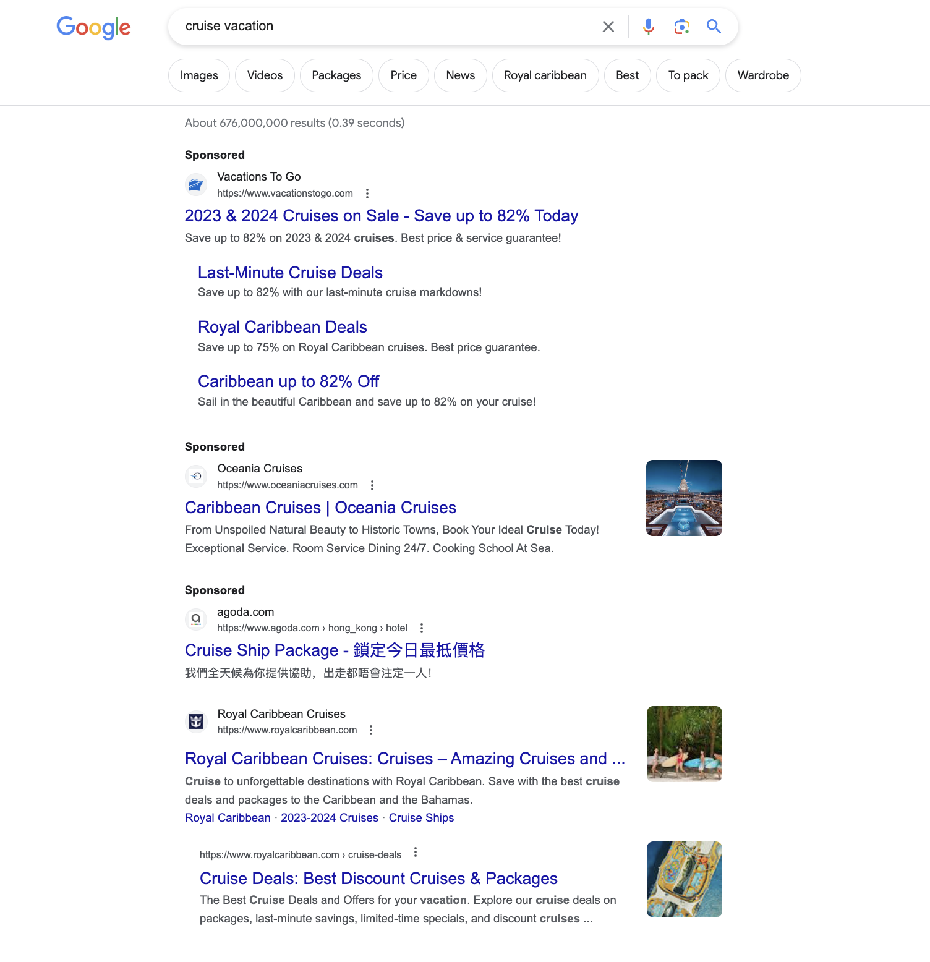

Slide 15
Search Jargon
Rank
Impression
Click
Conversion
Click through rate (CTR)
Bounce Rate (Q: what does it measure?)
Notes:
Bounce rate: rate of clicking on the google ads, go to the website, and go back to google after browsing only one page (unhappy with the search results)

Slide 16
Why would companies care about appearing higher on Google search results?

Slide 17
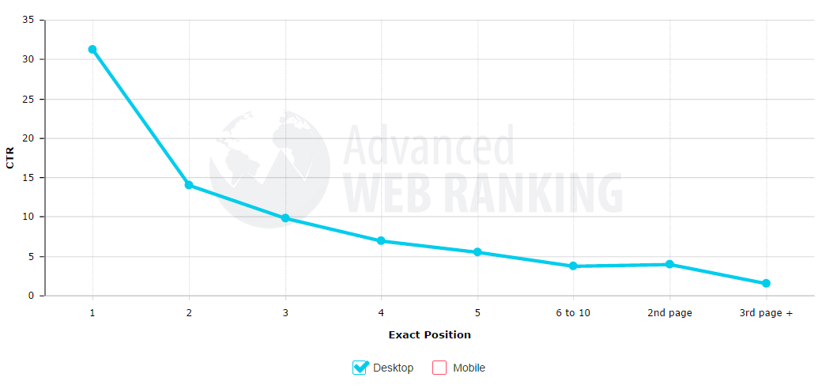
Organic CTR
Source: moz.com

Slide 18
Google’s “Golden Triangle”
Source: Mediative

Slide 19
In-class Task
Find a keyword that leads to the most and least number of sponsored ad on the first page of Google.

Slide 20
Search Engine Optimization (SEO)

Slide 21
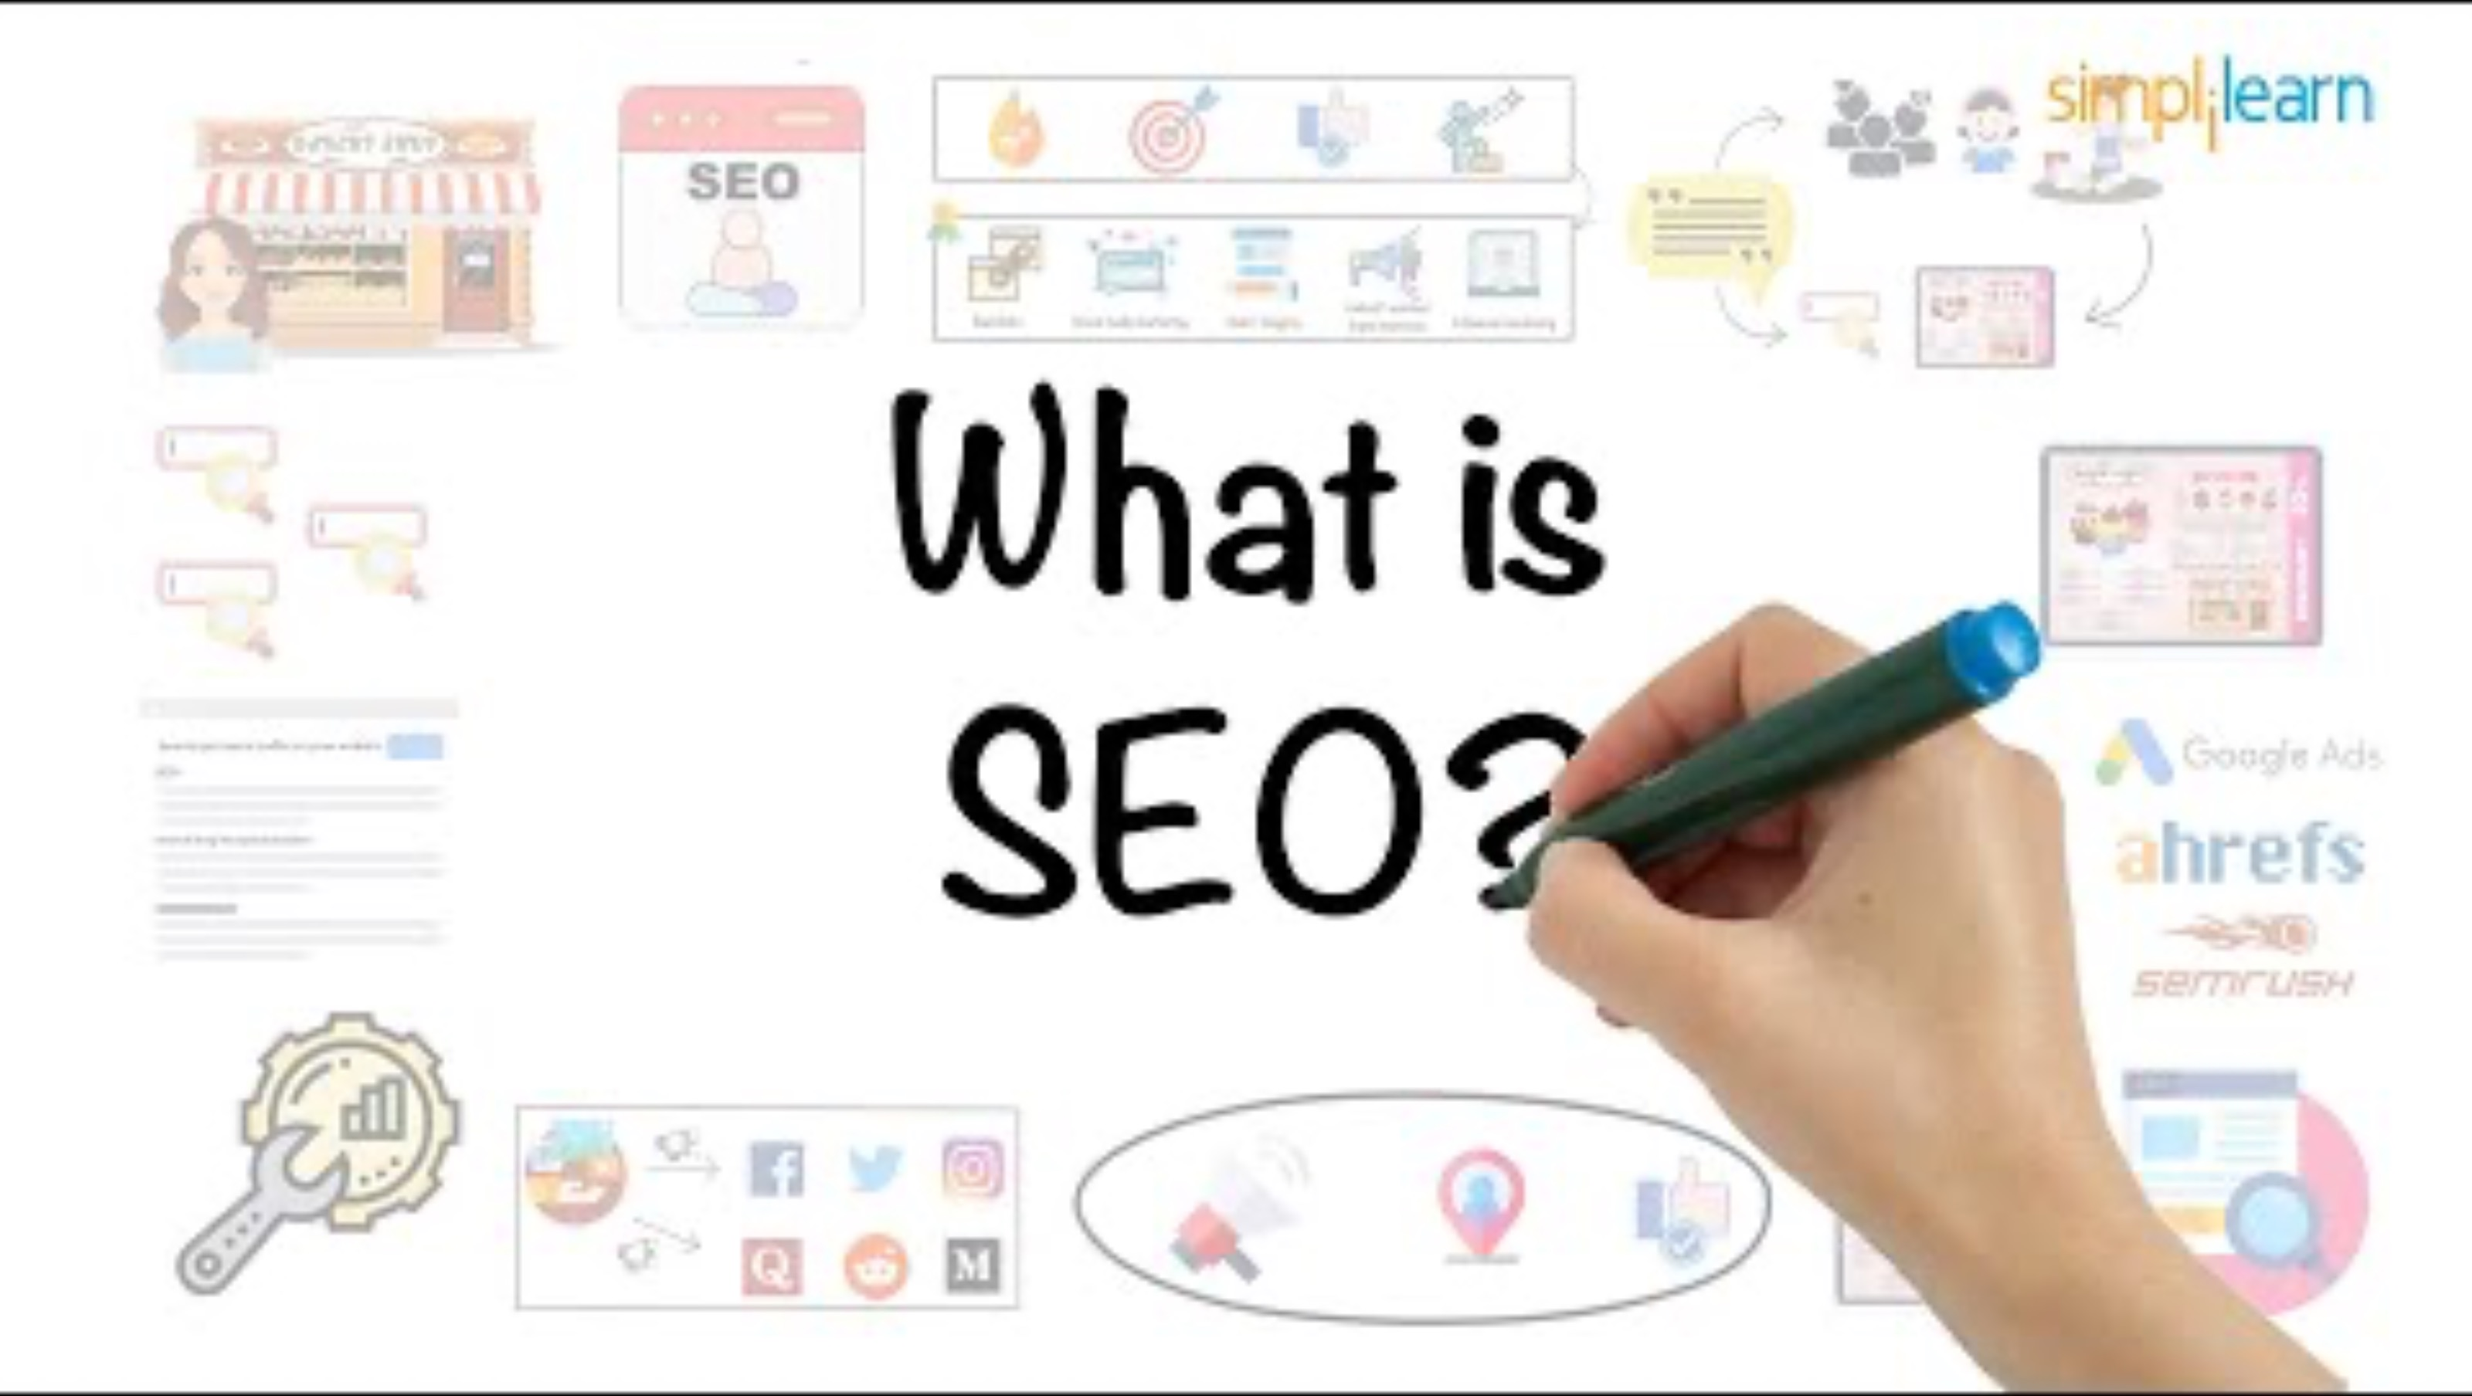
Source: https://www.youtube.com/watch?v=MYE6T_gd7H0

Slide 22
Search Engine Optimization (SEO)
Incoming Links (PageRank)
Relevant Content (Keyword Research)
Fast / Updated
Technical Structure (Google SEO Guide)
Mobile Optimized
Local First

Slide 23
Useful Tools
Google’s SEO Guide
Google Search Console
Google Ads Keyword Planner
Google Autocomplete
SpyFu.com
QuestionDB
Notes:
Illustrate the tools in class

Slide 24
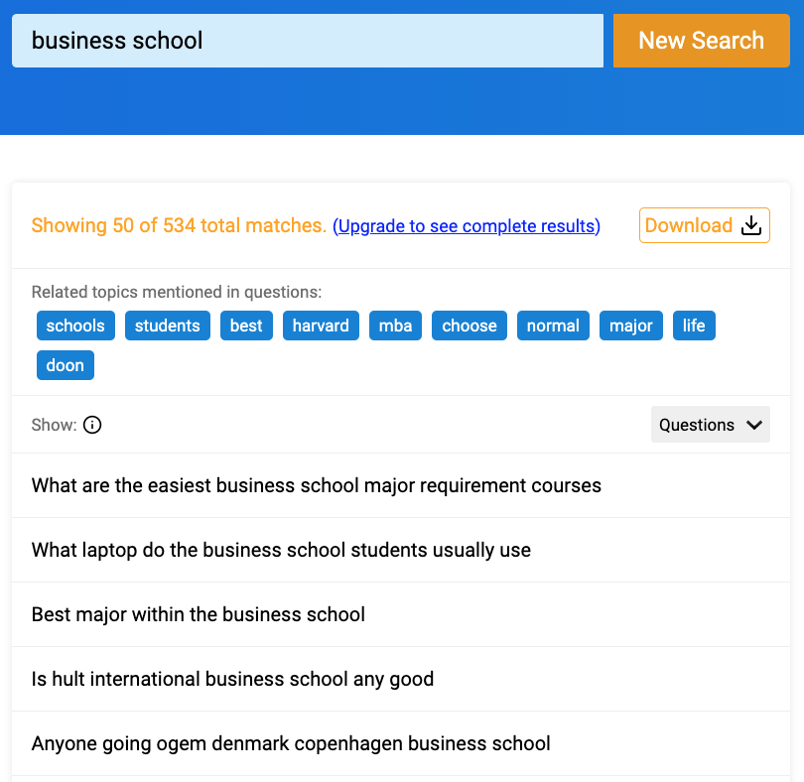

Slide 25
Exercise with your neighbor
Pick a website in one of these industries:
Fashion / Education / Gaming / Entertainment / AI
Guess:
How many visitors do these sites get in a day?
What share is from organic search?
Who are their biggest competitors?
What are their most popular search keywords?
Analyze using the tools we discussed:
What is the keyword that drives the most traffic?
What are keywords for which they rank highest?
Can you find keywords for which they don’t rank high, are relevant and have a lot of traffic volume?
What content would you create for these keywords?

Slide 26
SEO Beyond Google
Where else do you also perform search?

Slide 27
SEO for Social Media
Instagram – Convert to Creator or Professional Account
TikTok – Use analytics
Twitter - Analytics
LinkedIn
Notes:
Creator or Professional Account gives you more analytics info.

Slide 28
What do the platform care about
Rich content promoted by platform – their newest feature is the one they will push the most.
Textual, descriptive, rich content with a lot of engagement.
#hashtags
Music/song which is trendy

Slide 29
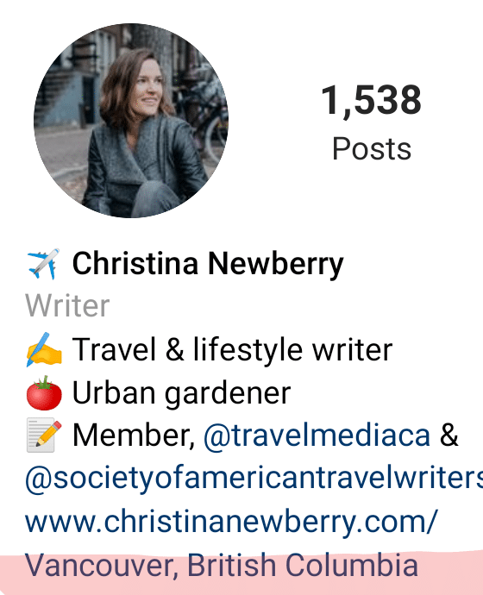
Optimize profile bio
Source: Hootsuite blog
Notes:
Professional account can also add a location to the profile

Slide 30
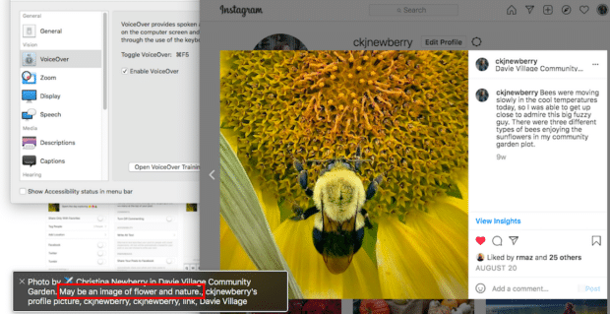
Add alt-texts (Instagram)
Source: Hootsuite blog
Notes:
Finding alt text: search “accessibility_caption” on page source.
The alt text value is shown in the place of the image when the image cannot be loaded (in case users have low bandwidth connections)
The alt text improves the accessibility of a page. Users who are visually impaired and use screen readers can hear a description of the image. This is also one of the core principles of SEO-friendly web design.
Search engines use the alt text to understand what an image is all about and it’s good for SEO.
In case the image is used as a link, the alt text is used as the anchor text.

Slide 31
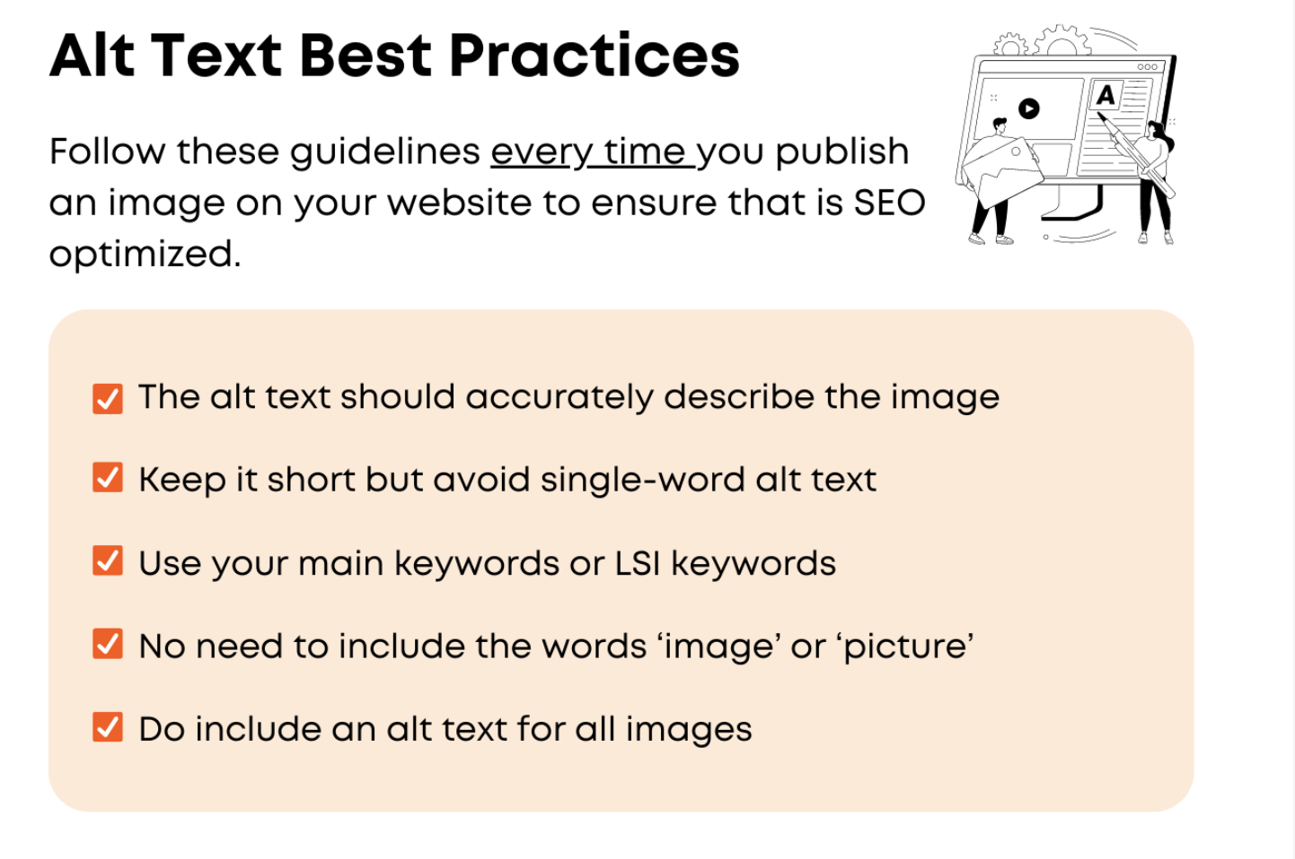
Source: https://www.reliablesoft.net/alt-text/

Slide 32
#hashtags
With your neighbor:
Pick a post on Instagram/TikTok/Twitter
Find three more useful hashtags that can be added to that post. (use the platform’s search or a hashtag research tool such as: https://influencermarketinghub.com/tools/)

Slide 33
SEO for Amazon
How do you search on Amazon?
What affects your decision to buy?
How would you improve your ranking?

Slide 34
What Amazon Cares About
Sales Velocity
Reviews
Pictures and their Quality
Good product descriptions

Slide 35
Summary
We focus on SEO because
Advertising is becoming expensive and less effective
Consumers trust search results more
SEO Optimized content teaches you about your customers and gives insights into ads
SEO is a slow and gradual process
Changes take time to show an effect
It’s a mix of art and science, with a lot of room for creativity

